Slide 1
VLSI DESIGN
LECTURE 11
BE(ECE)5TH SEMESTER

Slide 2
Sheet Resistance
Sheet resistance, often called sheet resistivity , is a measure of resistance of thin films that are normally uniform in thickness.
It is commonly used to characterize materials made by semiconductor doping, metal deposition and glass coating.
Difference between sheet resistance and bulk resistance.
The bulk resistance is the approximate resistance across the terminals of a component (e.g. Diode) when a forward voltage and current are applied across the diode.

Slide 3
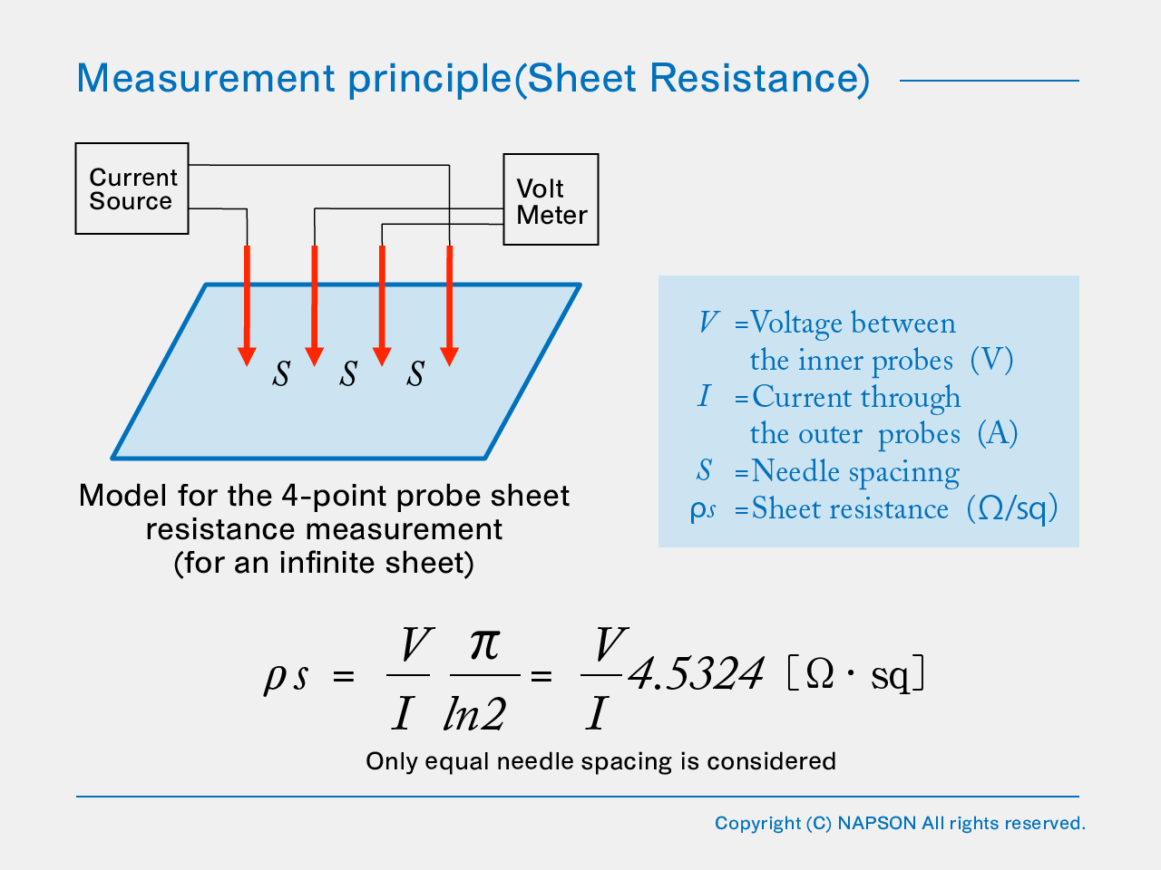
Characterization of Diffused layers

Slide 4
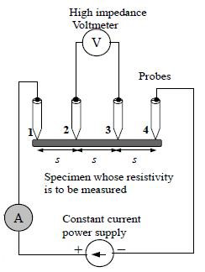
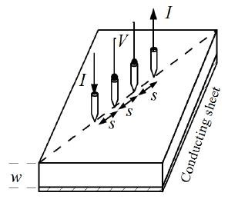
Resistivity by Four Probe Method
This method is employed when the sample is in the form of a thin wafer, such as a thin semiconductor material deposited on a substrate. The sample is millimeter in size and having a thickness w. It consists of four probe arranged linearly in a straight line at equal distance S from each other. A constant current is passed through the two probes and the potential drop V across the middle two probes is measured. An oven is provided with a heater to heat the sample so that behavior of the sample is studied with increase in temperature.

Slide 5
IC Packaging
The final series of production step involves bonding the circuit chips to a header in a suitable package connecting the circuit bonding pads to the external leads of the package, and encapsulating the whole unit.
IC, or integrated circuit, packaging refers to the material that contains a semiconductor device. The package is a case that surrounds the circuit material to protect it from corrosion or physical damage and to allow for mounting of the electrical contacts connecting it to the PCB.

Slide 6
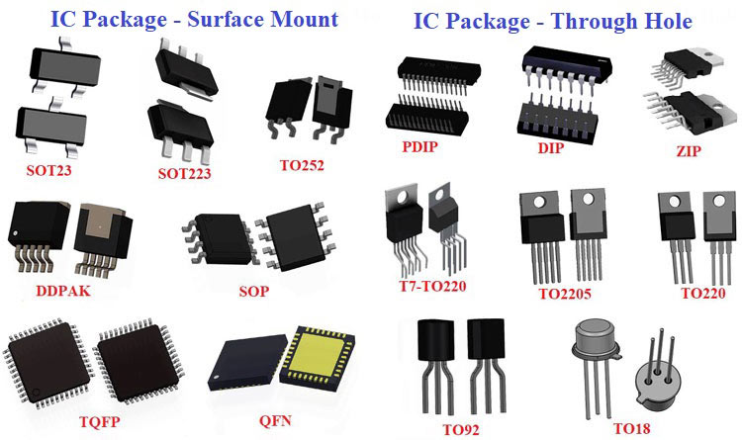

Slide 7
Basic functions of packaging
To protect the sensitive semiconductor device from external environment that could degrade the circuit performance.
To provide adequate mechanical protection.
To provide a convenient means for interconnecting many individually packaged circuits.
To act as a path for heat resulting from power dissipation in the IC, the package must dissipate this heat to the surrounding air or conduct it to a heat sink.

Slide 8
Factors affecting the package type
Environmental capacity.
Comparative interconnecting cost.
Comparative package cost
Component density per unit volume.
Comparative system size.
Three basic package types:
The flat pack
The metal can or transistor pack
The dual-in-line package.

Slide 9
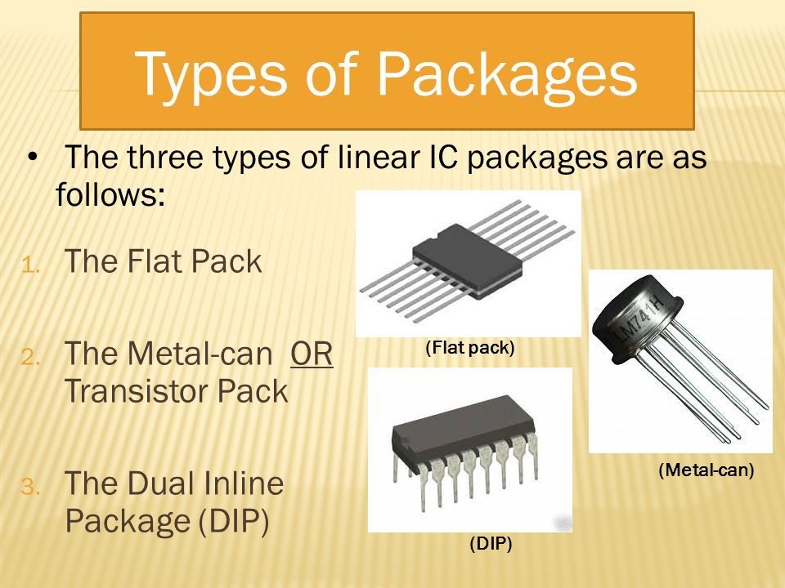

Slide 10
Package Materials
Plastic
Metal
Ceramic

Slide 11
Questions for you:
1. What is the difference between two probe and four probe method of resistivity measurement?
2. How four probe method is used to determine the resistivity of thin film?
3. What are the advantages of four probe method over two probe method.

